Slide 1
Security Close to the Applications
Aviatrix Distributed Cloud Firewall
ACE Solutions Architecture Team

Slide 2
NIST Tenets Covered
This module will cover two tenets of NIST Zero-Trust Architecture (ZTA)
Security Close to the Applications
Global, Dynamic and Centralized Policy Model
Tenet from NIST Publication 800-207 - Zero Trust Architecture (ZTA)
Assets and traffic moving between enterprise and non-enterprise infrastructure should have a consistent security policy and posture. Workloads should retain their security posture when moving to or from enterprise-owned infrastructure. This includes devices that move from enterprise networks to non-enterprise networks. This also includes workloads migrating from on-premises data centers to non-enterprise cloud instances.
Related Aviatrix Features
Aviatrix Distributed Cloud Firewall
Network Segmentation
Micro-Segmentation
ThreatIQ / ThreatGuard
GeoBlocking
URL Filtering / Internet Egress Traffic Filtering
Centralized Policy Engine
Tenet from NIST Publication 800-207 - Zero Trust Architecture (ZTA)
Access to resources is determined by dynamic policy—including the observable state of client identity, application/service, and the requesting asset—and may include other behavioral and environmental attributes.
Notes:
(You can’t protect what you cannot see)

Slide 3


As Architected with Lift-and-Shift, Bolt-on, Data Center Era Products…
Internet
Internet
“3rd Party Last Generation Firewalls”

Slide 4
In Reality…
Internet
Internet
Internet
Internet
Internet
Internet
Notes:
Shows 1. Current sec stack misses a lot and 2. We have been doing distributed inspection and enforcement for some time

Slide 5



This is bad! Expensive and Lacks Enterprise-Grade Security
Large FW VMs or Data Transfer
Internet
$$ Internet Egress
Internet
Internet
Egress
Internet
Internet
$$ Transit to FW
$$ Load-Balancers
$$ NAT GW
Data Transfer + Gateway
$$$
NAT
Gateways
$$$
Cloud
Workloads
Internet
AZ1
AZ2
Internet
App Environment
VPC / VNet
Notes:
NAT gateways are expensive and provide little value
If an attacker compromises a host, you can’t detect it and you can’t stop it
No visibility for data exfiltration
Often individual application VPCs are connected to the corporate network, and a single gap in the perimeter can compromise the entire network.

Slide 6
What If…
Internet
Internet
Internet
Internet
Internet
Internet

Slide 7


Firewalling Functions were Embedded in the Cloud Network Everywhere…
Internet
Internet
Internet
Internet
Internet
Internet

Slide 8
Centrally Managed, with Distributed Inspection & Enforcement…
Internet
Internet
Internet
Internet
Internet
Internet

Slide 9






And, What If it was more than just firewalling…
Internet
Internet
Internet
Distributed
Firewalling
Internet
IDS / IPS
SG
Micro-Segmentation
Advanced NAT
Threat Prevention
Internet
Decryption
URL
Filtering
Internet

Slide 10
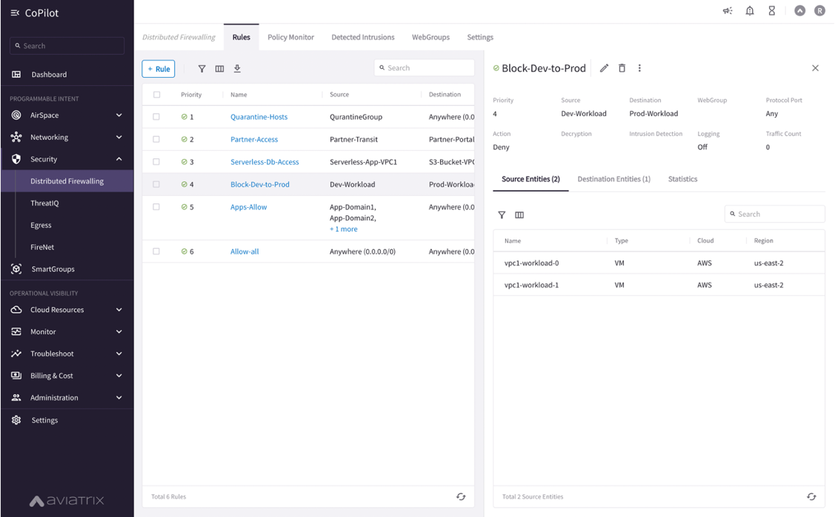
And, What If Policy Creation Looked Like One Big Firewall…
Centralized Policy Creation
Distributed Enforcement
NSG
Micro-Segmentation
Threat Prevention
IDS / IPS
Advanced NAT
Distributed
Firewalling
Decryption
URL
Filtering
Aviatrix CoPilot

Slide 11
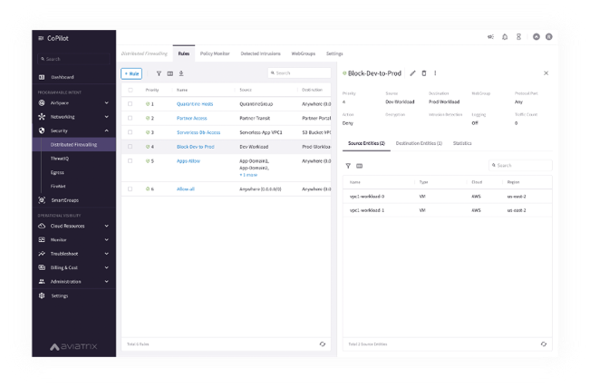



A Distributed Cloud Firewall…
Where and How Policies Are Enforced Is Abstracted…

Slide 12
Enabling Aviatrix Distributed Cloud Firewall (DCF)
Global Policy – Distributed Enforcement

Slide 13
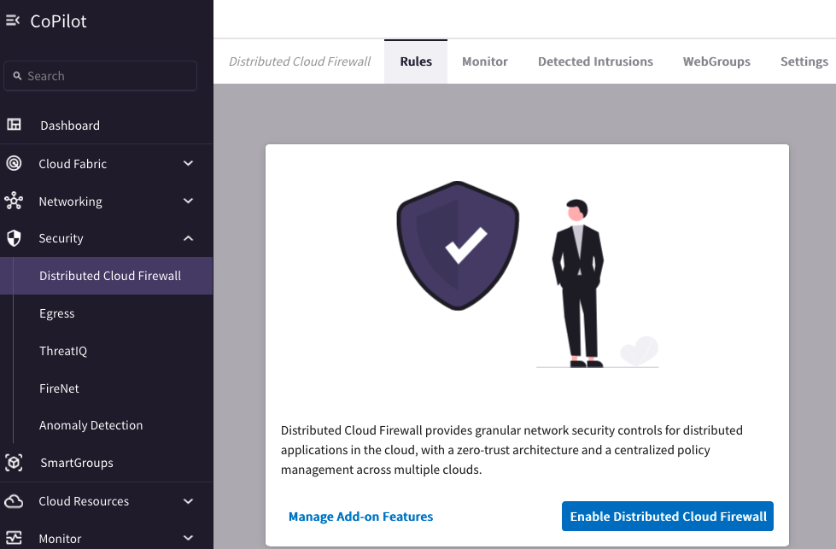
Enable Distributed Cloud Firewall
Distributed Cloud Firewall provides granular network security controls for distributed applications in the cloud, with a zero-trust architecture and a centralized policy management across multiple clouds.

Slide 14
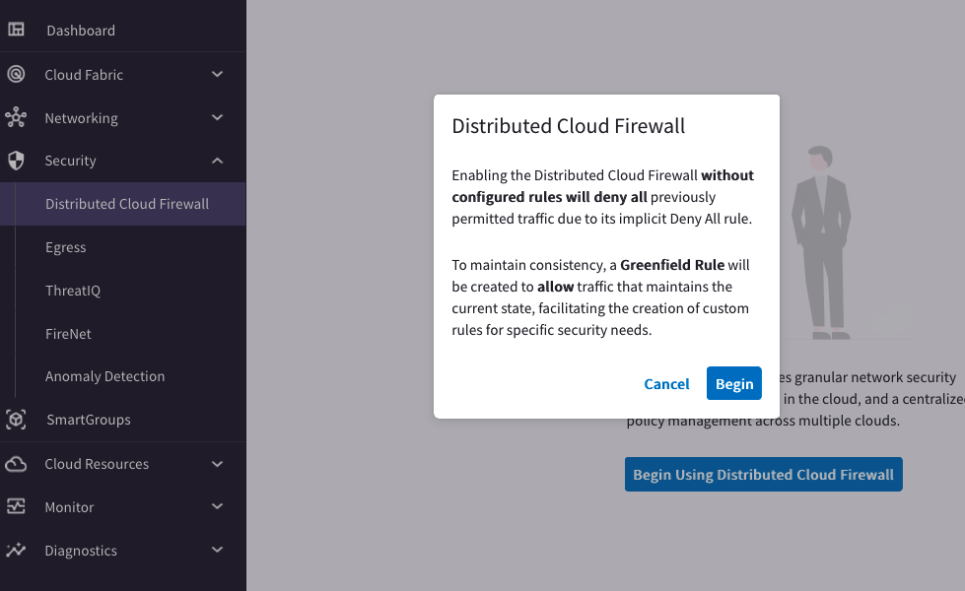
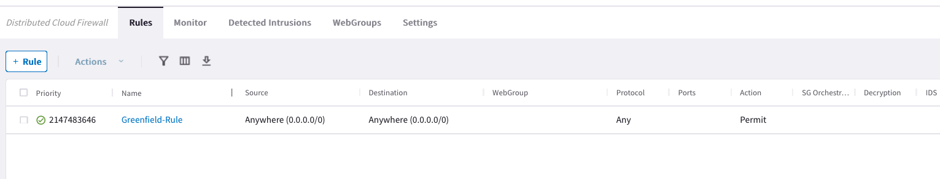
Enable Distributed Cloud Firewall
Enabling the Distributed Cloud Firewall without configured rules will deny all previously permitted traffic due to its implicit Deny All rule.
To maintain consistency, a Greenfield Rule will be created to allow traffic that maintains the current state, facilitating the creation of custom rules for specific security needs.
DENY LIST MODEL
allow all data to flow, except for exactly what you say should be stopped.

Slide 15
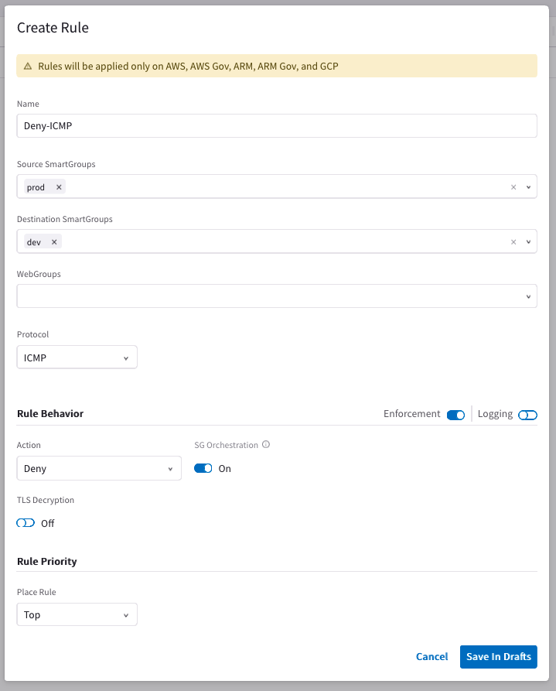
Global Policy Rule Creation and Enforcement
Enforcement ON
The policy is enforced in the Data Plane
Enforcement OFF
The policy is NOT enforced in the Data Plane
The option provides a Watch/Test mode
Watch what traffic hits the deny rule before enforcing the rule in the Data Plane.
Security Group Orchestration
Provides both Intra VPC/VNET traffic and Inbound Internet Access Control

Slide 16
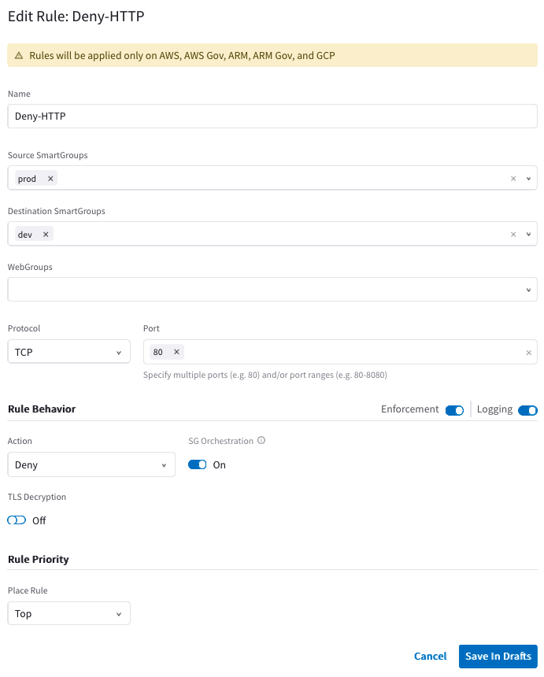
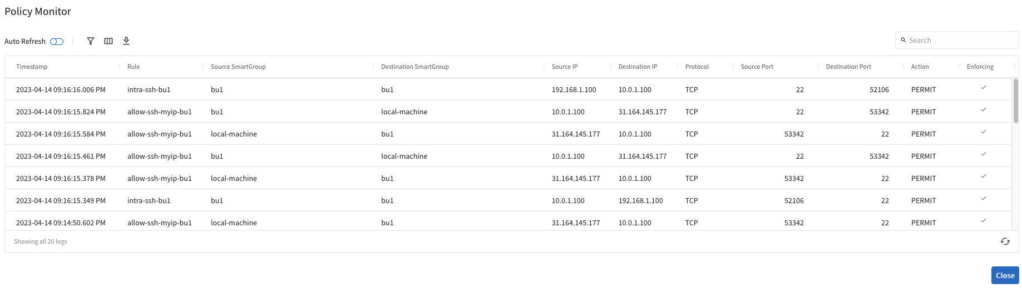
Rule Logging
Logging can be turned ON/OFF per rule
Aviatrix CoPilot Syslog/Netflow captures all logs

Slide 17
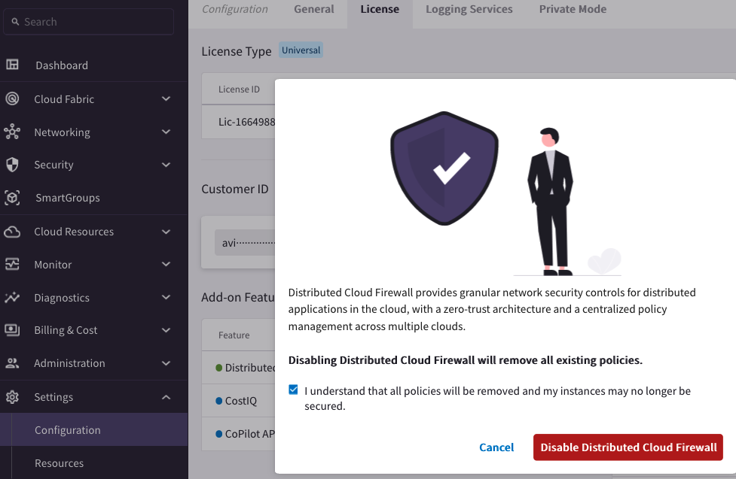
Disabling Distributed Cloud Firewall

Slide 18




TLS Decryption: Basic TLS Connection
ISRG-Root-CA
-- aviatrix.com
TCP 3-Way Handshake
Server
Client
Aviatrix.com
CA Trust Bundle
Server Cert
Client Hello: TLS Version, Cipher list, SNI etc
Godaddy-Root-CA
ISRG-Root-CA
Server Hello: Selected TLS Version, Selected Cipher, Server Cert
TLS-1
Http Request: URI
Decrypt with TLS-1
Decrypt with TLS-1

Slide 19
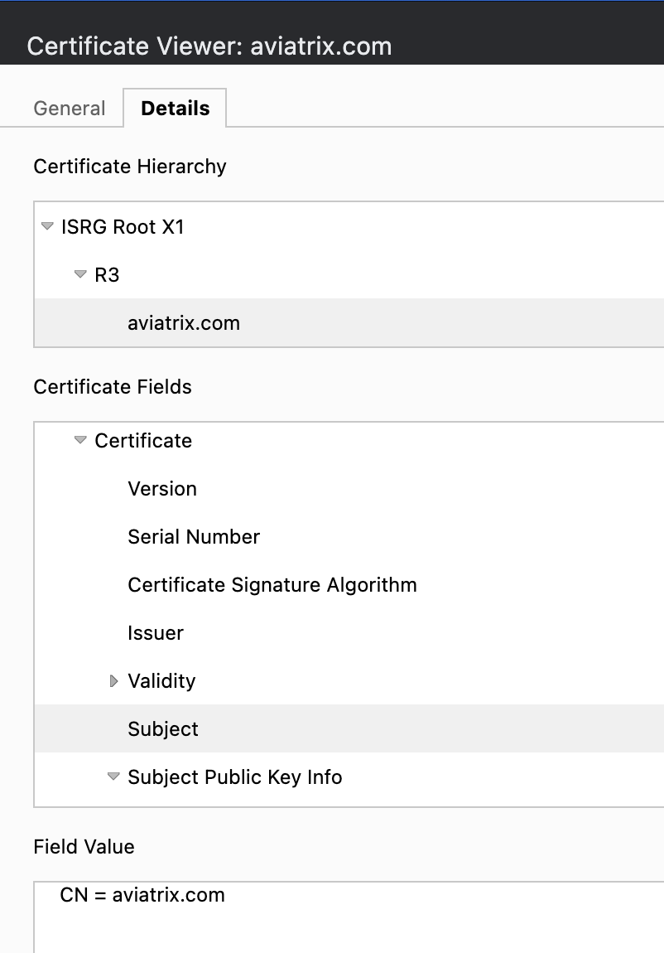
TLS Decryption: PKI/ KMS and Trust Bundle
Certificate Hierarchy
Root
Intermediate
Server Cert (Leaf Cert)
Certificate Fields
Issuer
Validity
Subject
Trusted Root CA Bundle
Used by the Client and/or Proxy Gateway to Identify/ Trust the Original Server Cert
Decryption CA Cert
Used by the Decryption/Proxy gateway to generate a new Proxy-Server Cert and Sign it with the Decryption CA Cert

Slide 20





TLS Decryption: Basic TLS Decryption
Signed by Public CA
TCP 3-Way Handshake
Spoke
Proxy Server
Server
Client
Proxy Client
Server
ISRG-Root-CA
-- aviatrix.com
Pvt-Root-CA
- Pvt-Decrypt-CA-1
Proxy Trust Bundle
Client Trust Bundle
Godaddy-Root-CA
ISRG-Root-CA
Aviatrix.com
Godaddy-Root-CA
ISRG-Root-CA
Pvt-Root-CA
Client Hello: TLS Version, Cipher list, SNI (aviatrix.com) etc
Server Cert
Proxy Client Hello:
TLS Version, Cipher list, SNI (aviatrix.com) etc
On the fly Signed by Pvt Decrypt CA
Pvt-Root-CA
- pvt-Decrypt-CA-1
- aviatrix.com (Proxy)
Server Hello: Selected TLS Version, Selected Cipher, Server Cert (aviatrix.com)
Pvt-Root-CA
- Pvt-Decrypt-CA-1
Proxy Server Hello : Selected TLS Version, Selected Cipher,
Proxy Server Cert (aviatrix.com)
TLS-1
TLS-2
Encrypt with TLS-1
Decrypt with TLS-1
Encrypt with TLS-2
Decrypt with TLS-2
Http Request: URI
Http Request: URI

Slide 21
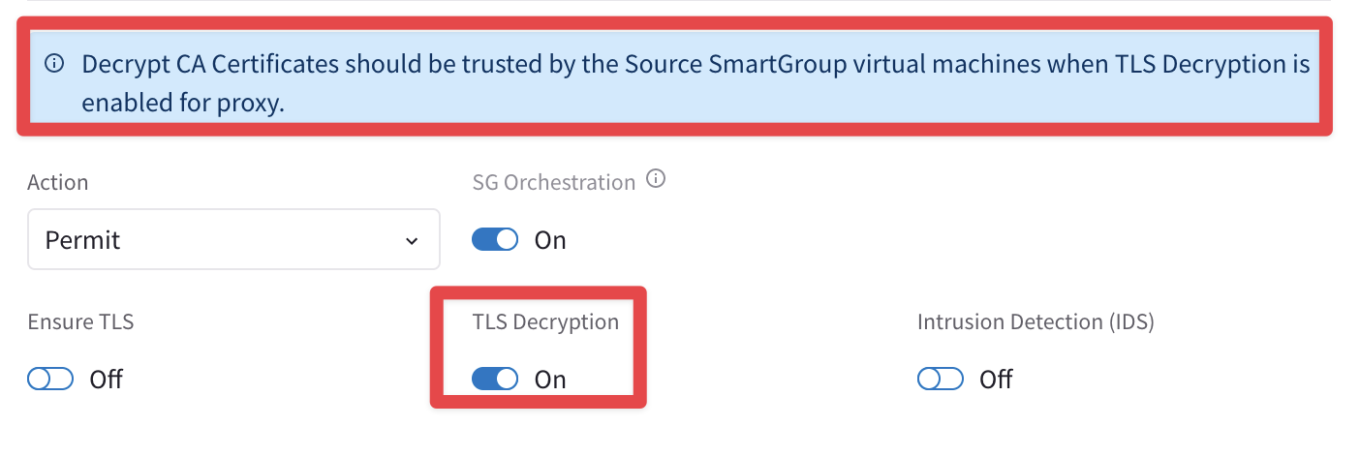
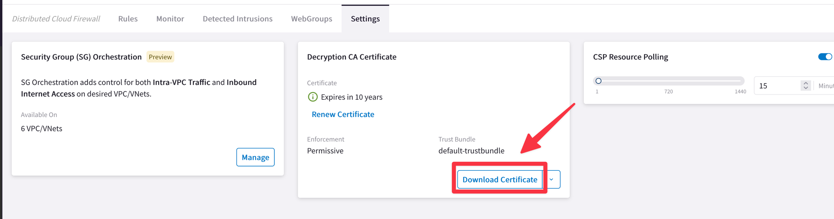
TLS Decryption: Decryption CA Cert
Download the Decryption CA Bundle.
Distribute the bundle across all the workloads.
Decrypt CA Certificates should be trusted by the Source SmartGroup virtual machines when TLS Decryption is enabled for proxy.

Slide 22





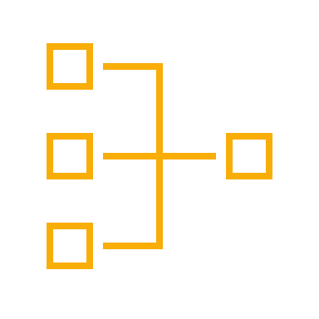

Aviatrix DCF: Intra and Inter SmartGroups Rules
Smart Groups
VPC
VPC
VNet
VNet
VPC
VPC
VNet
VNet
Apache
Nginx
Region 1
Region 2
A rule between SGs can be defined for achieving the INTER-SMARTGROUP communication
Region 1
Region 2
INTRA-SMATGROUPS- RULE: is defined within a Smart Group for dictating what kind of traffic is allowed/prohibited among all the instances that belong to that Smart Group
INTER-SMARTGROUP-RULE: is defined among Smart Groups for dictating what kind of traffic is allowed/prohibited among two or more Smart Groups.

Slide 23
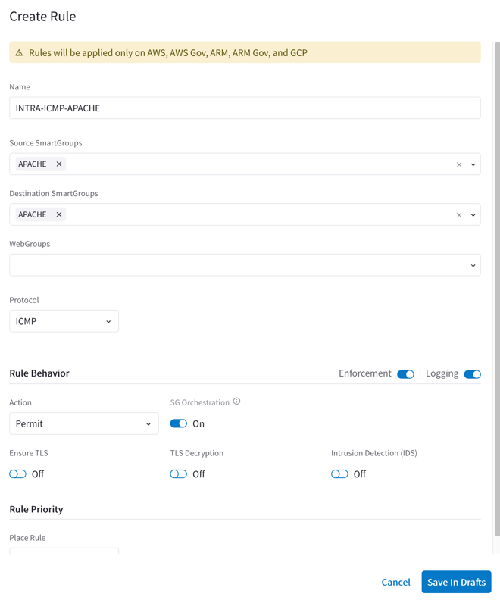

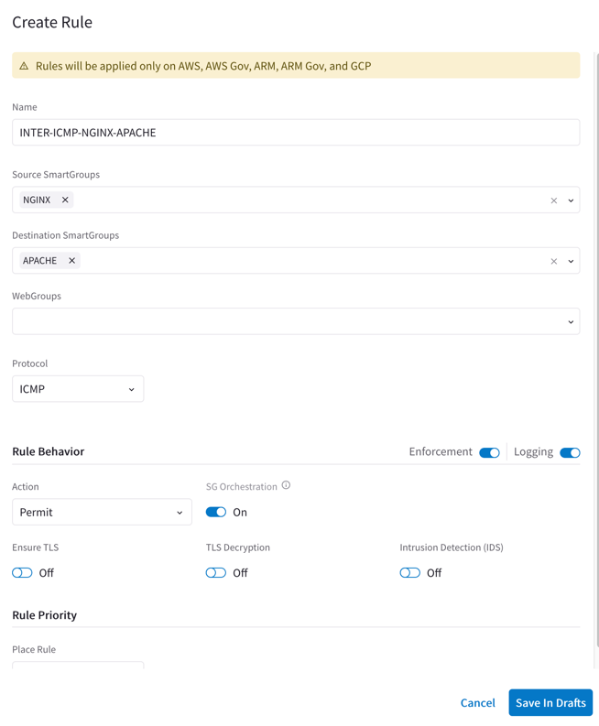

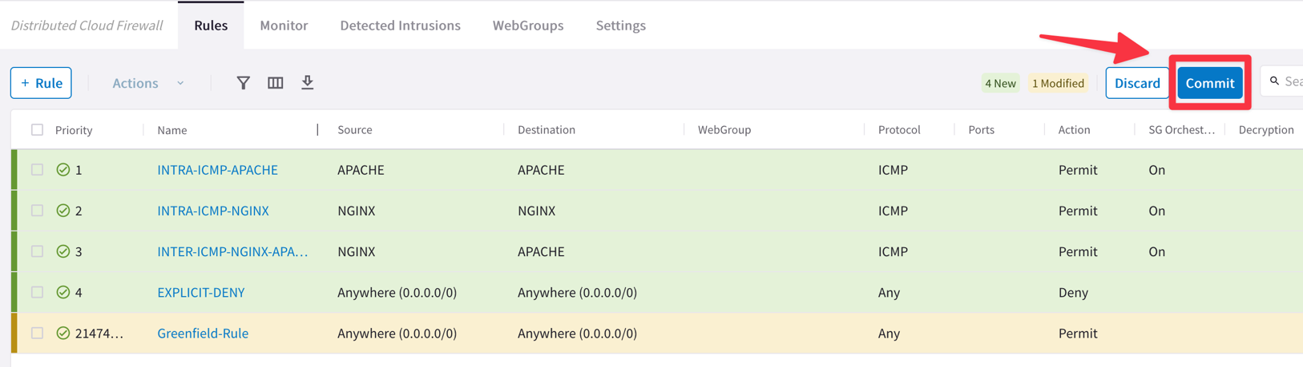
Aviatrix DCF: Intra and inter SmartGroups Rules
SmartGroup
Apache
SmartGroup
Nginx
SmartGroup
Nginx
SmartGroup
Apache
VPC
VPC
VNet
Region 1
Region 2
Rule changes are saved in Draft state.
When you apply a rule to a SmartGroup, please keep in mind that there is an Invisible Hidden Deny at the very bottom.
To save the changes click on “Commit”
Discard will trash the changes
Rule is stateful, this means that the return traffic is allowed automatically
A rule between SGs can defined for achieving the INTER-SMARTGROUP communication

Slide 24
DFW Engines At-a-Glance
eBPF (extended Berkeley Packet Filter) Engine (L4) → Stateful Firewall Rule (forwarding path)
WebProxy ATS (Apache Traffic Server) Engine (L7) → it is triggered whether WebGroups or TLS Decryption are required
Suricata Engine (DPI) → Signature of the payload (only in IDS mode at the moment)
Spoke Gateway
Suricata
IDS
IDS = Yes
Mirror Packet
IDS = Yes
Mirror Packet
WebGroup Miss – Continue Evaluating L4/L7
eBPF Engine
( L4 )
Match Src/Dst
Contains WebGroups or Decrypt
ATS Engine
( FQDN/URL + TLS Decrypt )
IPTables, Routing, NAT ->
Stateful FW
Legacy FQDN
Netflow (L4/L7)
WebGroups Match - Allow
Packet In
Deny
L4 Allow
WebGroups Match - Deny
Drop
Drop

Slide 25
Supported Capabilities
Capability | 6.7 | 6.8 | 6.9 | 7.0 | 7.1
Distributed Cloud Firewall is supported in the following cloud providers: | AWS, Azure | AWS, AWS GovCloud, Azure, Azure Government, and GCP | AWS, AWS GovCloud, Azure, Azure Government, and GCP | AWS, AWS GovCloud, Azure, Azure Government, and GCP | AWS, AWS GovCloud, Azure, Azure Government, and GCP
You can configure up to 500 SmartGroups | x | x | x | x | x
You can have up to 3000 CIDRs per SmartGroup | x | x | x | x | x
Number of rules per policy | 64 | 2000 | 2000 | 2000 | 2000
Number of port ranges | 1 | 64 | 64 | 64 | 64
Security Group Orchestration is supported |  |  |  | x (Azure) | x (AWS and Azure)

Slide 26
3rd Party Firewall Service Insertion (Aviatrix FireNet)
Centralized model
Use as necessary

Slide 27






Aviatrix FireNet For 3rd Party FW Service Insertion/Chaining
Aviatrix Controller
Bring Your Own Appliance
Firewall Service Insertion
E-W / Egress / Ingress / all traffic
High Performance Encryption (HPE)
Active / Active – Across AZs
No IPsec / No BGP / No SNAT required
Automated Control and Management
Repeatable architecture across regions/clouds
Centralized firewall deployment
Vendor API integration
UDR and VPC Route propagation
Improved Failure Detection and Failover
Health Check monitoring
Forwarding Algorithm Options
Intelligent traffic steering and firewalling based on traffic type
5-tuple and 2-tuple
Firewall Bootstrap Support
Firewall zero-touch deployment capability in Azure and AWS
Prod VPC
Prod VPC
Dev VPC
Dev VPC
Prod VNet
Prod VNet
Dev VNet
Dev VNet
Transit VPC
Transit VPC
Transit VNet
Transit VNet
FireNet
FireNet
FireNet
FireNet
High Performance Encryption
AWS - REGION
AZURE - REGION
High Performance Encryption
Direct
Connect
Express
Route
Site 2 Cloud
Site 2 Cloud
On-Prem DC
Branches
Extranet
Branches
Extranet
On-Prem DC
Notes:
East/West Traffic
Egress Traffic

Slide 28


Aviatrix Certified Engineer (ACE)
COMMUNITY
https://aviatrix.com/ACE
https://community.aviatrix.com

Slide 29
Aviatrix Security Solutions Reference Sheet
Learning Resources For Aviatrix Distributed Cloud Firewall for Egress | Partner Learning Resources For Aviatrix Distributed Cloud Firewall
Solution Overview Reduce Cost on native NAT webinar TCO Calculator (Save Cost, Improve Security) SelfService Tool to Deploy Aviatrix DCF For Egress https://selfservice.aviatrix.com/ Deployment Guide in AWS | Solutions Overview Aviatrix Distributed Cloud Firewall webinar TCO Calculator (Save Cost, Improve Security) Aviatrix Distributed Cloud Firewall Landing Page
Misc. Security Resources for Partners | Marketplace Listings
Deal Registration Partner Portal Partner Registration Previous Partner Webinars | AWS Azure GCP

Slide 30
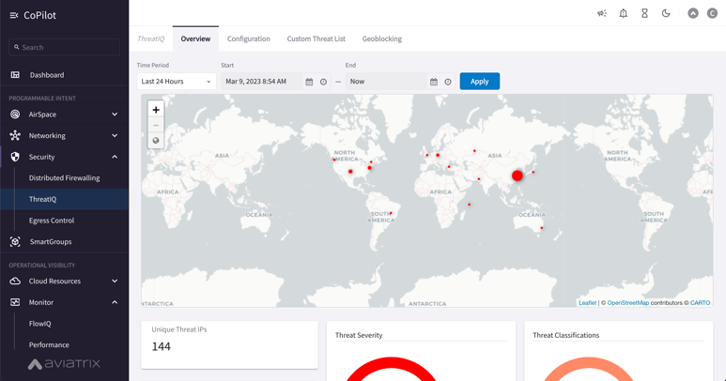
Brownfield Design Scenario Phase 1: Replace CSP Native NAT Gateways. Reduce Cloud Costs and Improve Security Without Impacting Architecture
Internet
Internet
Internet
Replace CSP NAT Gateway with Aviatrix
Internet
Internet
Aviatrix
Secure Egress
NAT Gateways
Cloud
Workloads
Internet
AZ1
AZ2
Internet
App Environment
VPC / VNet
Notes:
Applications owners take the easiest path to making the application work – while taking small security precautions to defend from the internet (putting into private subnet)
Every application owner has their own perimeter – even if they’re connected to a transit
Result is expensive (NAT gateways, added data transfer fee)
No security
No control
No visibility

Slide 31
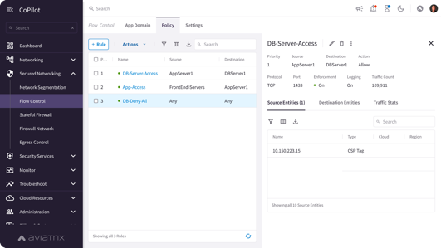





Brownfield Design Scenario Phase 1 : Add E/W Firewalling and Microsegmentation, Reduce Bolt-on NGFWs
Aviatrix
Controller
Aviatrix
CoPilot
Internet
Centralized Management, Visibility, and Control
Distributed Firewalling
IDS / IPS
AZ1
AZ2
AZ1
AZ2
AZ1
AZ2
AZ1
AZ2
NSG SG
Threat Prevention
Aviatrix
Distributed Cloud Firewall Gateways
Aviatrix
Distributed Cloud Firewall Gateways
Advanced NAT
Micro-Segmentation
Aviatrix
Distributed Cloud Firewall Gateways
Aviatrix
Distributed Cloud Firewall Gateways
Distributed Inspection and Policy Enforcement
Cloud
Workloads
Cloud
Workloads
Cloud
Workloads
Network Segmentation
Cloud
Workloads
Decryption
App 1
App 2
URL Filtering
App 3
App 4
DC/Branch/Colo
Notes:
Visualization attaching an application to the Aviatrix Zero Trust Transit and adding East-West controls and micro-segmentation.

Slide 32



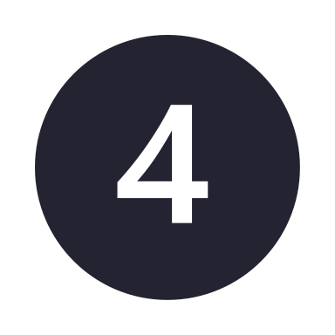





Reduce Cloud Costs, Improve Security, Non-Disruptive Deployment
Reduce Costs
Increase Security
Increase Security
Reduce Costs
$
$
NAT
Egress
NGFW
Replace CSP NAT Gateways
Reduce Cost Immediately
Add Distributed Cloud Firewall
for Egress
Add Full Distributed Cloud Firewall
with Secure Transit for E/W
Take a Bite Out of Firewall Costs
with Distributed Cloud Firewall
Aviatrix Secure NAT Gateway
Non-Disruptive Insertion
Advanced NAT Features
Distributed Cloud Firewall Capable
Visibility and Alerting
Distributed Cloud Firewall for Egress
Advanced Threat Detection
Suricata IDS/IPS
ID Known Malicious IPs
Automated Threat Blocking
Anomaly Detection
Distributed Cloud Firewall for Private Networks
East – West Firewalling
Multicloud Networking
Full Visibility
Micro Segmentation
Deep Packet Inspection
Vulnerability Scanning
Advanced Threat Intelligence
Reduce Number of Existing Firewalls Required for E/W
Reduces License Costs
Reduces Operational Costs
Reduces CSP Data Transfer Costs
Reduces Business Risk

